Slide 1
THE SMART PILL BOX(Extended)
Stores , Organizes & Dispenses

Slide 2
Abstract
The purpose of this project is to design and develop a smart pill box to help individuals with autism, the elderly, and people with disabilities keep track of their medicine and manage their health. This innovative solution will solve the problem of missed or incorrect doses of medicine, which can have serious consequences for these populations. The design will be compact, user-friendly and easy to operate, making it accessible to people of all ages and abilities. The smart pill box will be equipped with advanced features such as RFID tracker, path detection, and object detection.
The smart pill box will be an essential tool for ensuring the health and well-being of individuals with autism, the elderly, and people with disabilities. By reducing the risk of missed or incorrect doses of medicine, this project will make a significant impact on the quality of life for these populations.

Slide 3
List of Components
Name | Quantity
Microchip AVR-IoT WA Development Board | 1
Arduino Mega 2560 | 1
SG90 Micro Servo Motor | 4
Itead Newton NX8048To070(Generic 7.0”) | 1
Adafruit 16-channel 12-bit PWM/Servo Driver | 1
Speaker: 0.25W, 8 Ohms | 1
Adafruit Photo transistor IR Light Sensor | 4
Adafruit 5mm IR LED( 940 nm) | 4
Ultrasonic Sensor- HC-SRo4 | 1
Parallax Feedback 360 High Speed Servo | 1
Adafruit 5V 2A Switching Wall Power Supply | 1

Slide 4
Timeline
Review 1
Review 2
Review 3
tit
tit
tit
con
con
con

Slide 5
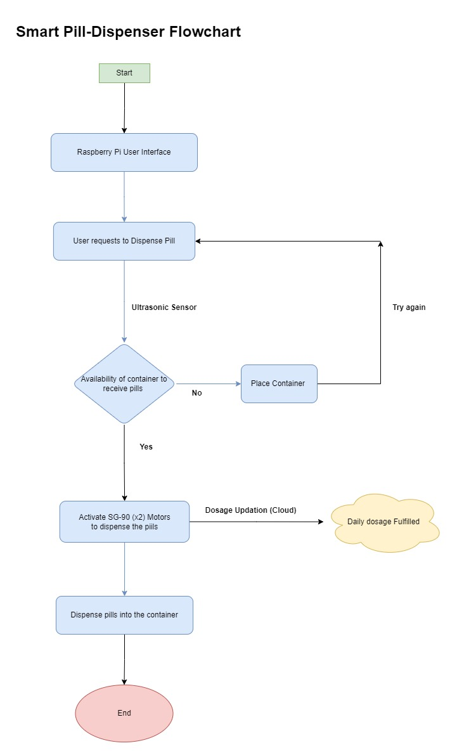
Flowchart

Slide 6
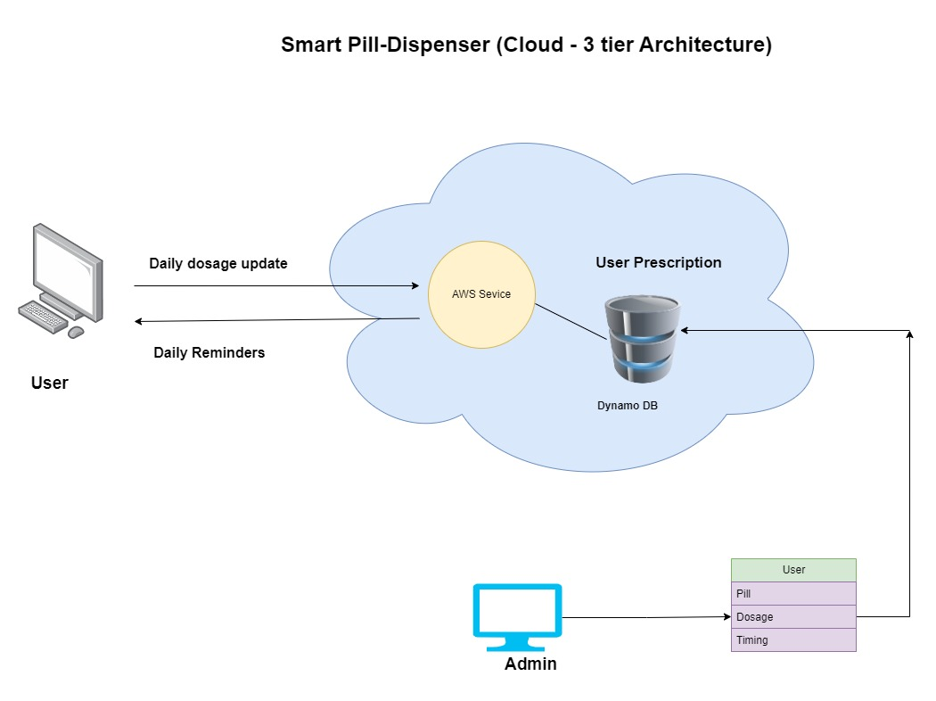

Slide 8
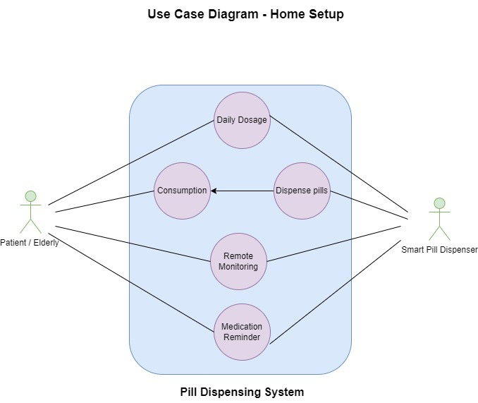

Slide 9
Added Functionalities
01
Alarm buzzer
Alert individuals with hearing impairments
02
Speech recognition
Speech recognition for the visually impaired
03
Alert/Refill Mechanism
The refill and expiration alerts are a key aspect of the Smart Pill Box's comprehensive approach to health management.
04
Real time monitoring
This helps to prevent missed doses and ensure that patients are taking their medication as prescribed, providing peace of mind and improving overall health outcomes.

Slide 10
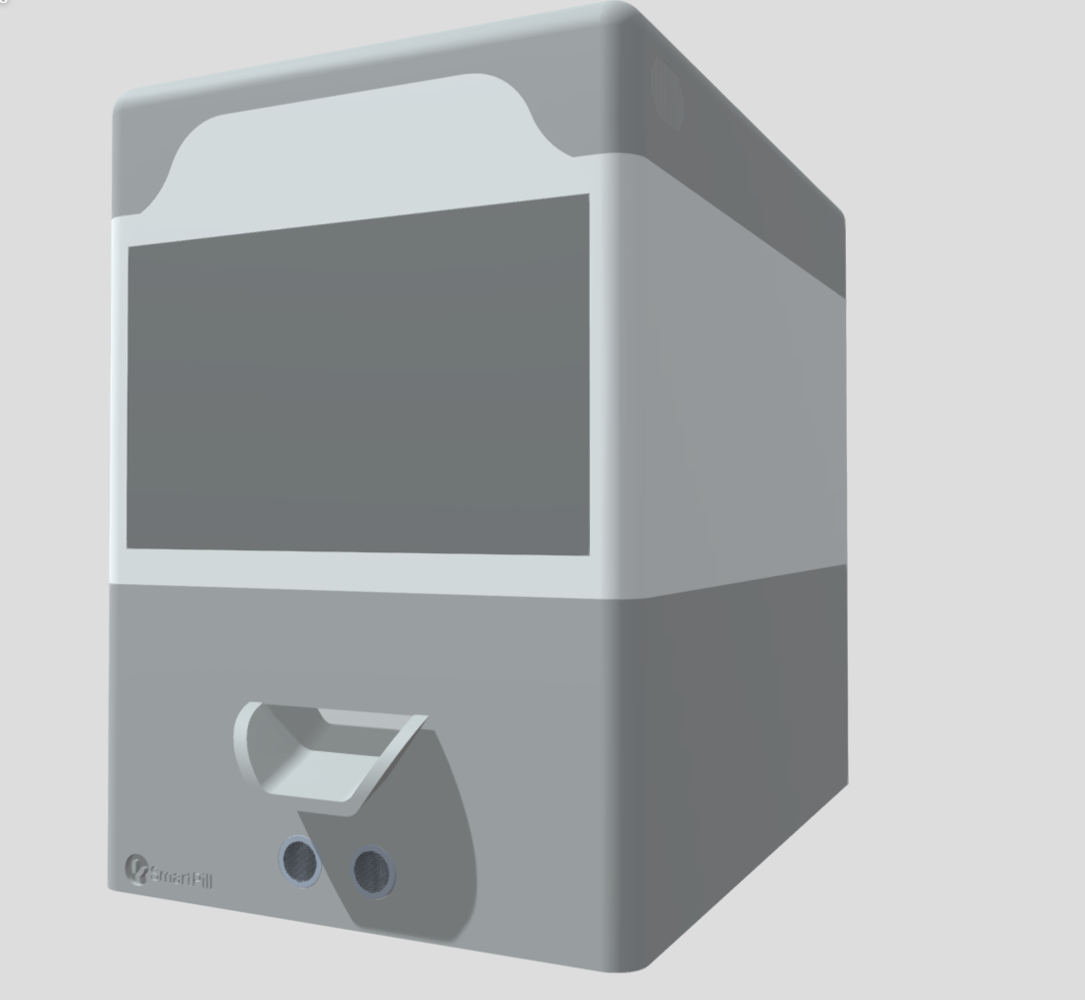
3-D model(side view)

Slide 11
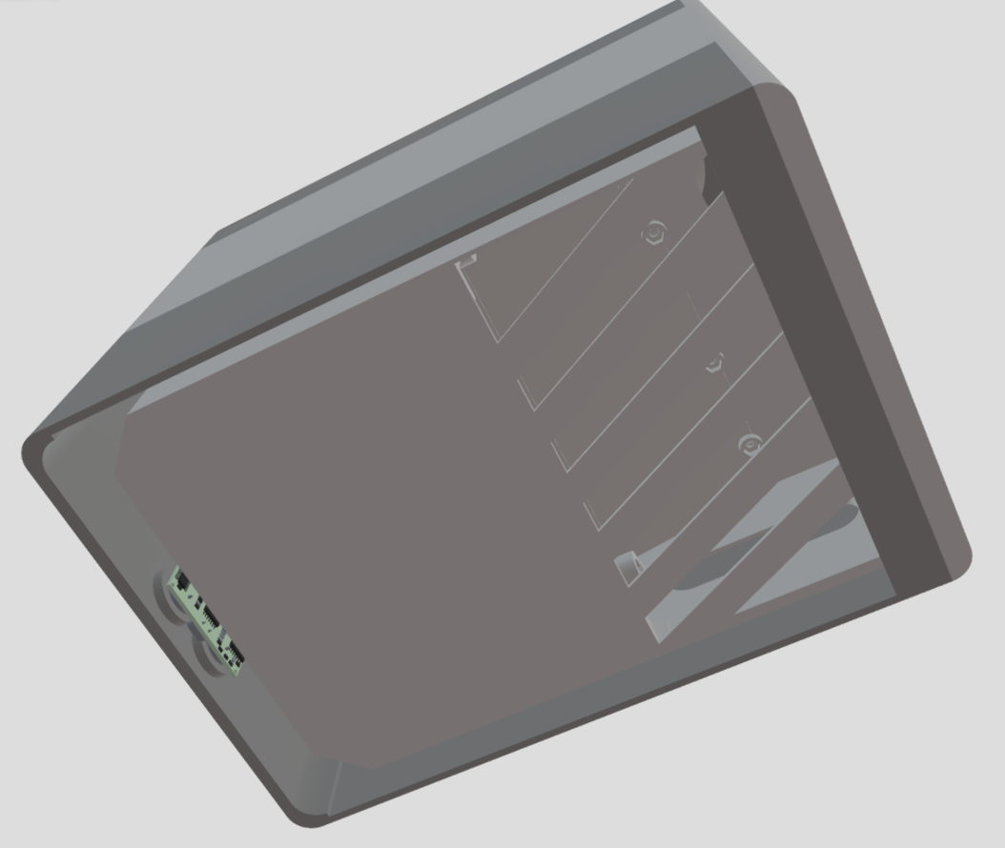
3-D model(bottom view)

Slide 12
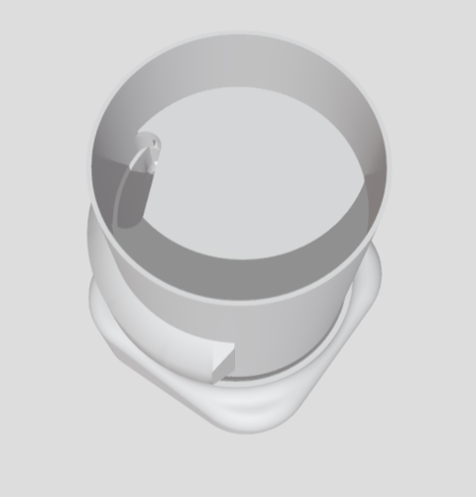
3-D model- Pill container

Slide 13
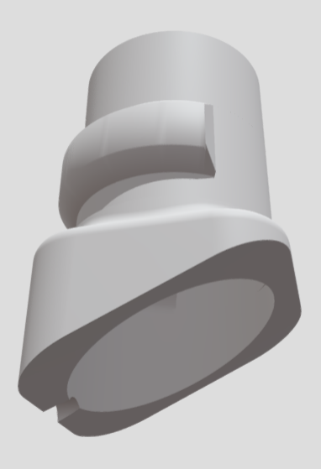
3-D model- Pill container(bottom view)

Slide 14
Workload Distribution
Dhyan & Jeevantika - Mobile App development + PPT
Ivan & Aditya – Coding + AWS
Priyam & Khajan – Circuit and Components

Slide 15
TEAM MEMBERS
20BCE7013 Aditya Patil
20BCE7648 Dhyan
20BCI7097 Ivan Philip Christopher
20BCR7087 Jeevantika Gurung
20BES7003 Khajan Singh
20BES7012 Priyam Mascharak

Slide 16
Conclusion
In conclusion, the Smart Pill Box is a cutting-edge solution for managing health and ensuring that patients with autism, the elderly, and people with disabilities never miss a dose of their medication. Its advanced features, including automatic medication reminders, real-time monitoring of pill intake, and path detection technology, make it a comprehensive and easy-to-use solution for managing health. The Smart Pill Box is a crucial tool for improving the quality of life for these populations and ensuring that they receive the care and support they need to stay healthy and active. We are confident that this project will have a positive impact on the lives of countless individuals and make a meaningful contribution to the field of health management.

